Slide 1
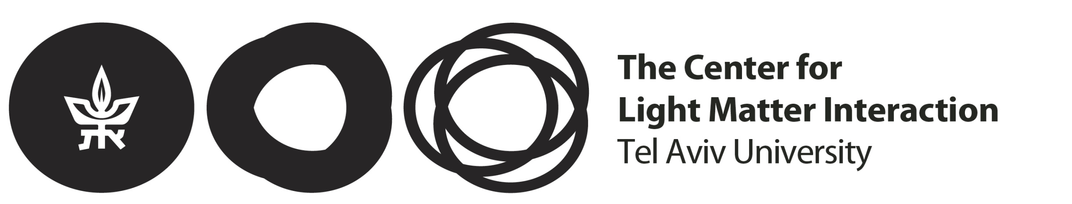
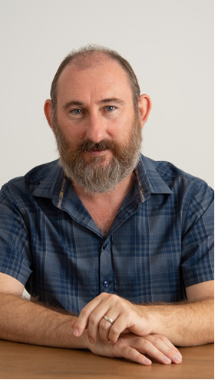
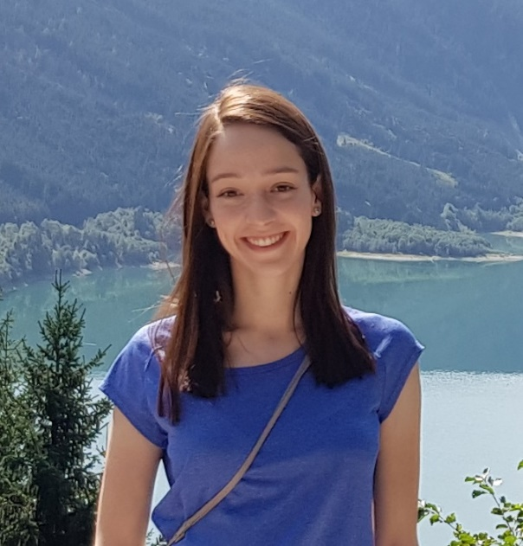
LMI Special Seminar:
Advanced Entanglement for Quantum Information Encoding
in Photonic States
Liat Nemirovsky Levy
Postdoc, Philip Walther's group
University of Vienna
Wednesday May 20th, 2026, 13:00-14:00
Light refreshments and drinks will be served at 12:30
Seminar room, nano building
Abstract: Entanglement is a central resource in quantum information science. Advanced forms - such as high-dimensional, multipartite, and hyperentanglement - offer new capabilities by expanding the Hilbert space and enabling more complex correlations. Multipartite entanglement involves correlations among more than two subsystems; high-dimensional entanglement extends beyond qubits to qudits; and hyperentanglement refers to entanglement across multiple degrees of freedom simultaneously.
In this talk, I will present new approaches for the generation and control of such entangled photonic states, and explore their use as resources for encoding and manipulating quantum information. I will describe our experimental and theoretical work on generating a new type of highly entangled photonic states via spatial and polarization modes, and show how combining multiple degrees of freedom can enhance the channel capacity in quantum systems.
Finally, I will introduce a topological scheme we developed to protect entanglement in integrated photonic platforms, offering a new route toward scalable, resilient quantum photonic technologies.
Best,

