Slide 1

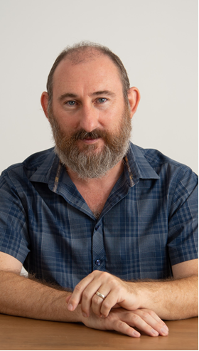

LMI Seminar:
New Avenues in Chip-Scale Atomic Quantum Sensors
Prof. Liron Stern
The Institute of Applied Physics,
Hebrew University in Jerusalem
Wednesday June 24th, 2026, 13:00-14:00
Light refreshments and drinks will be served at 12:30
Auditorium 011, Engineering Classroom Building,
Faculty of Engineering, Tel-Aviv University
Abstract: The miniaturization of atomic quantum sensors is reshaping how we measure magnetic fields, electromagnetic radiation, and time. By combining micromachined vapor cells, integrated photonics, and advanced laser architectures, it is now possible to bring quantum-level precision to compact, robust, and deployable devices. In this talk, I will highlight a few examples in chip-scale magnetometry, timekeeping, and electrometry studied in our lab. First, I will discuss remote atomic magnetometry, where atomic sensors are interrogated and read out optically from a distant station through free-space and fiber links, allowing magnetic-field mapping over tens of meters with sensitivities at the picotesla level in unshielded environments. Next, I will present work on optical clocks and frequency division using micro-frequency combs, demonstrating hybrid-locked SiN Kerr-microcomb systems that achieve residual fractional instability at the 10⁻¹⁶ level at short averaging times, reaching the 10⁻¹⁸ level at averaging times of a few thousand seconds, and support compact, chip-integrated optical timekeeping. Finally, I will show our results on Rydberg-atom electric-field sensing in wafer-scale Pyrex-Si-Pyrex micromachined vapor cells, where narrow-linewidth Rydberg spectroscopy enables detection of RF fields from 15 GHz down to 300 MHz with sensitivities down to approximately 10 μV/cm, illustrating subwavelength quantum antennas on a chip. Together, these results highlight how hybrid atomic-photonic architectures are redefining the landscape of chip-scale quantum sensing.

