Slide 1

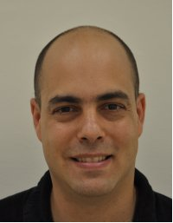
LMI Special Seminar:
Leveraging High-Dimensional Qudits for Quantum Communication
and Computation
Prof. Yaron Bromberg
Institute of Physics , Hebrew University
Wednesday January 7th, 2025, 13:00-14:00
Light refreshments and drinks will be served at 12:30
Auditorium 011, Engineering Classroom Building, Faculty of Engineering, Tel-Aviv University
Abstract: Photons can carry quantum information not only in two-level systems (qubits) but also in d-level systems known as qudits. A single photon distributed across d optical modes can encode up to log_2(d qubits of information, enabling more efficient use of quantum resources and greater resilience to noise. This advantage, however, comes at a price: implementing quantum gates and performing measurements in high-dimensional Hilbert spaces is significantly more demanding than in the qubit case.
To address these challenges, I will present our recent work on developing new protocols and optical hardware for quantum communication and computation with high-dimensional qudits encoded in the temporal or spatial modes of single and entangled photons. I will discuss our experimental implementations of quantum key distribution using weak coherent pulses [Sulimany et al., NPJ Quantum Information 11, 16 (2025)], single photons from quantum dots [Halevi et al., Optica Quantum 2, 351 (2024)], and entangled photon pairs [Lib et al., Optica Quantum 3, 182 (2025)]. In the latter, we demonstrated projective measurements in two mutually unbiased bases for $d = 25$ using a multi-plane light converter (MPLC). I will also show how the same MPLC platform can be applied to perform elementary operations in measurement-based quantum computation with high-dimensional cluster states [Lib and Bromberg, Nat. Photonics 18, 1218 (2024)].

